Slide 1
In silico PK/PD models
Bridging basic research and clinical practice
Ronette Gehring
Professor of Veterinary Pharmacotherapeutics and Pharmacy

Slide 2
Dose
Effect

Slide 3
v
Pharmaceutical phase
Pharmacokinetic phase
Pharmacodynamic phase
Drug in systemic circulation
Drug interaction with receptor
Dose
Drug at site of action
Effect
Formulation
Route of administration
Disintegration
Dissolution
Compliance
Absorption
Distribution
Metabolism
Excretion
Drug receptor interactions
Effects
Toxicity
Therapeutic window

Slide 4
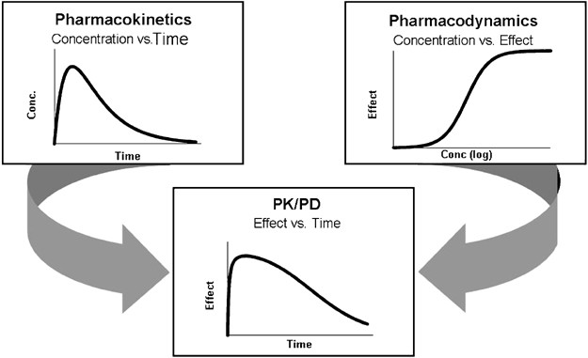
Source: Mehrotra, N., Gupta, M., Kovar, A. et al. The role of pharmacokinetics and pharmacodynamics in phosphodiesterase-5 inhibitor therapy. Int J Impot Res 19, 253–264 (2007)

Slide 5
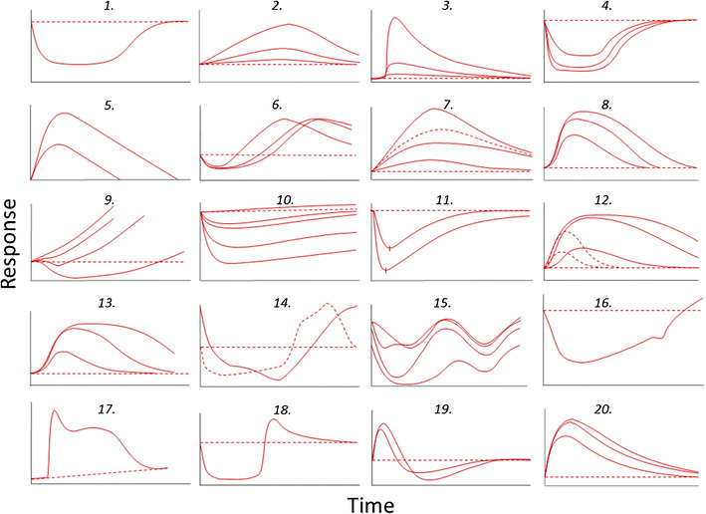
Source: Gabrielsson J, Hjorth S. Pattern Recognition in Pharmacodynamic Data Analysis. AAPS J. 2016 Jan;18(1):64-91.

Slide 6



Dose
Effect

Slide 7
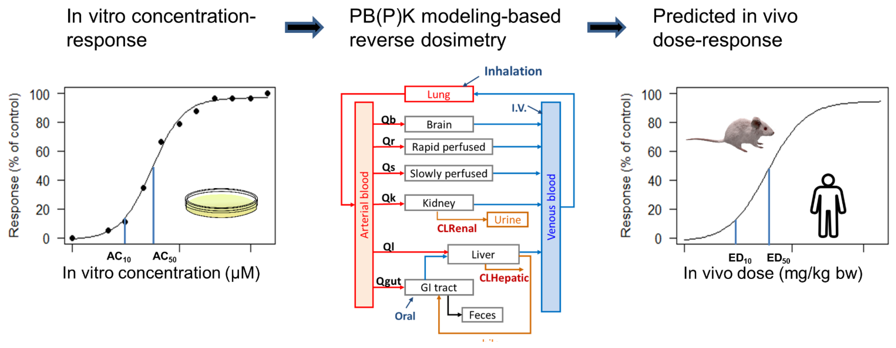

Slide 8
Challenges
Indirect and non-linear relationships
Baselines, delays, redundancies and feedback loops
Intra- and interexperimental variability
Intra- and interindividual variability

Slide 9
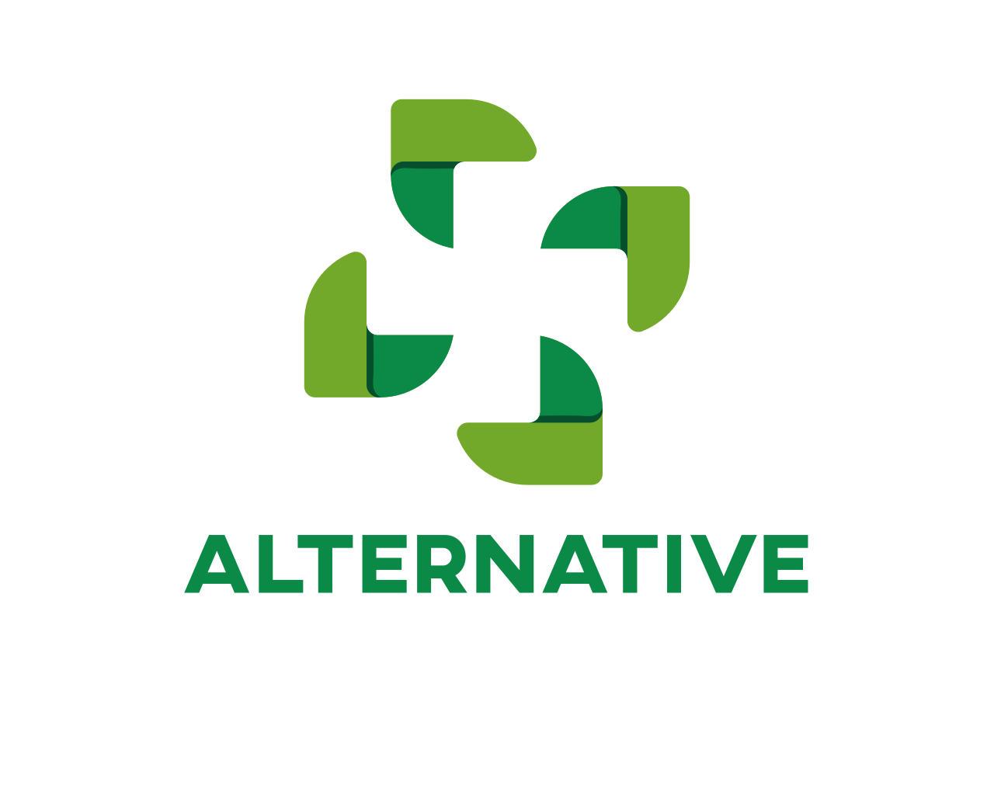
Indirect and non-linear relationships
Cardiotoxicity related to oxidative stress

Slide 10
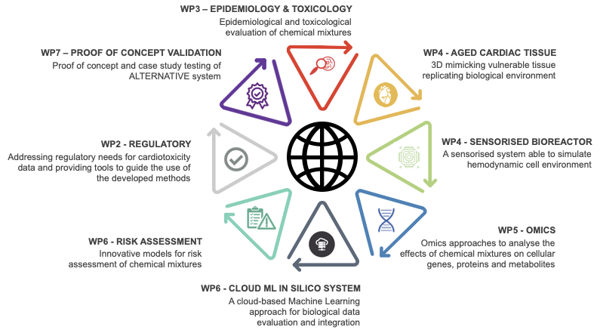
Overview of the ALTERNATIVE project

Slide 11
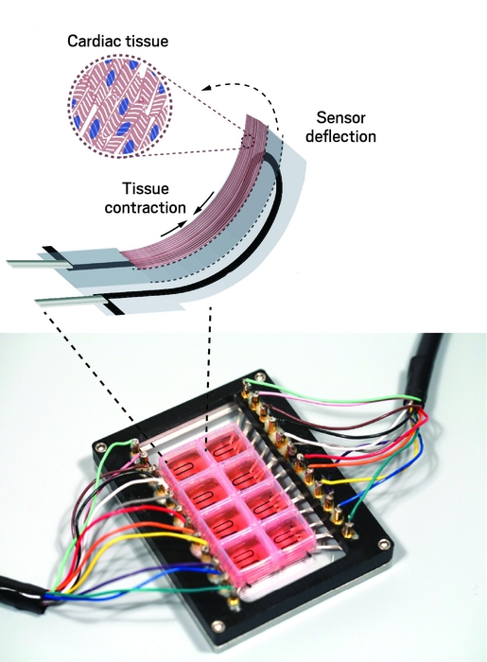
Advanced in vitro model
  hiPSC-CMs + HCAECs
  3D-structure in bioreactor, scaffolds
  Heart physiology is maintained
  Electrodes for beating
  Constant fluid flow allows chronic exposure
Outcome measures:
  Mechanistic analysis and biomarkers of effect (omics)
  Oxidative stress (ROS content)
  Cell viability
  Mitochondrial dysfunction (mitochondrial metabolic activity)

Slide 12
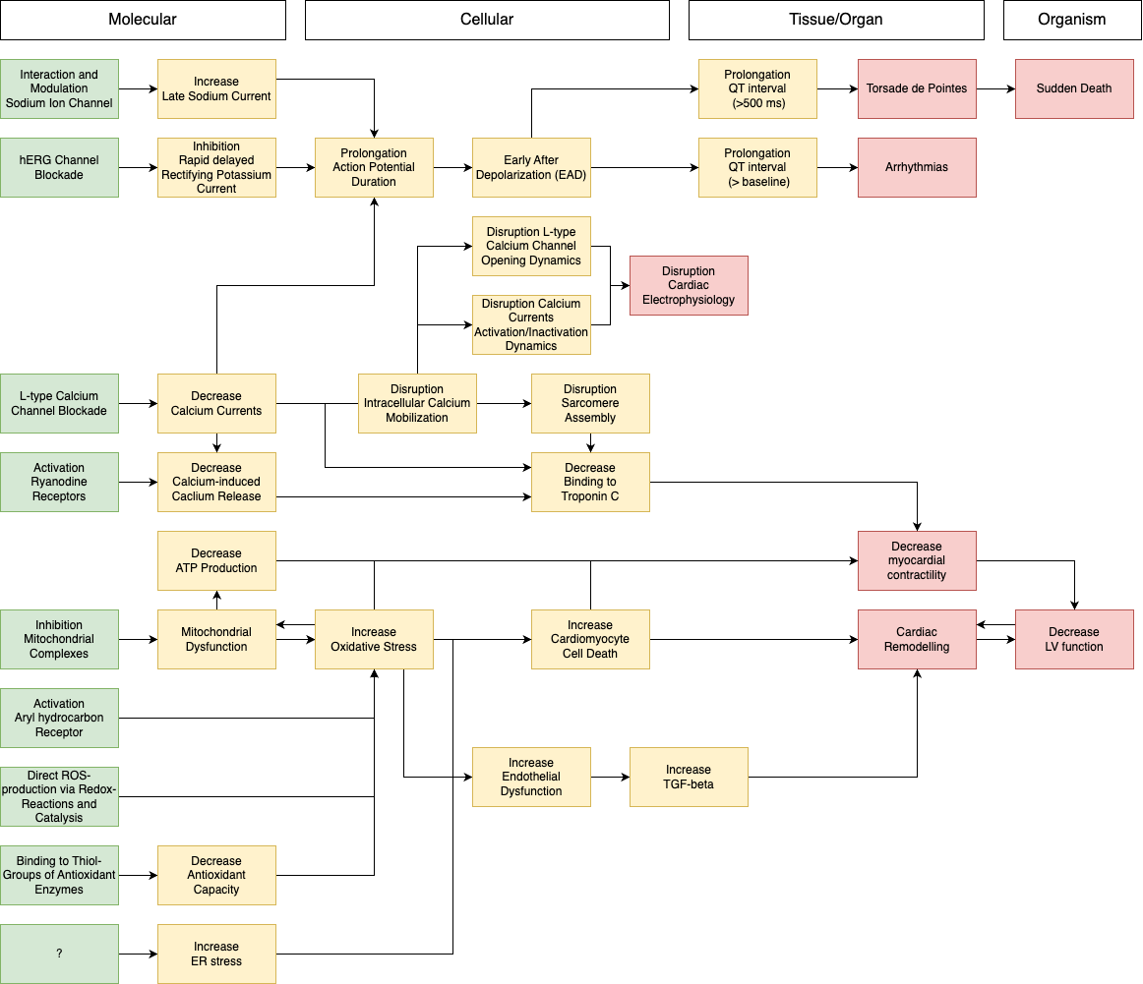
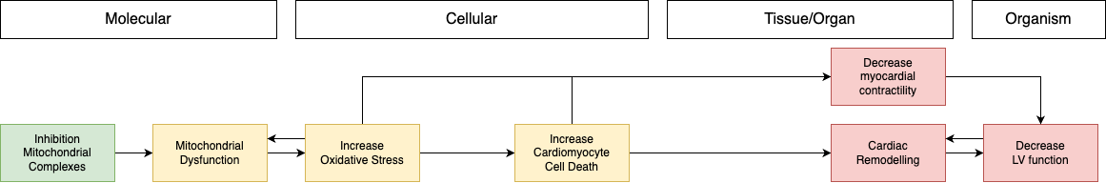
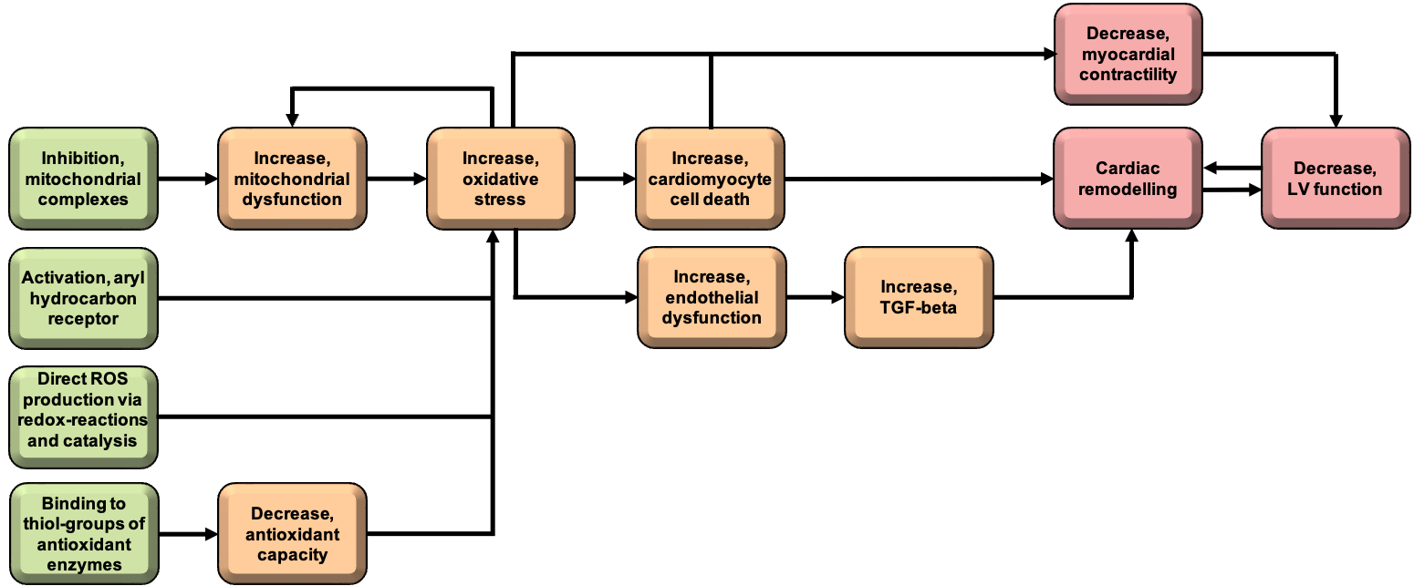
Adverse Outcome Pathway for Cardiotoxicity
High metabolic demand generating ROS
Limited antioxidant capacity of CMs
Limited regenerative capacity of CMs
Accelerated with age
.
.
.
Framework for understanding cardiotoxic mechanisms
.
.
.

Slide 13
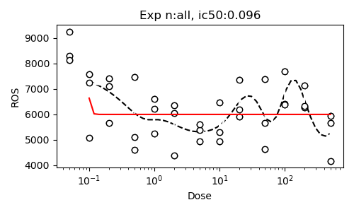
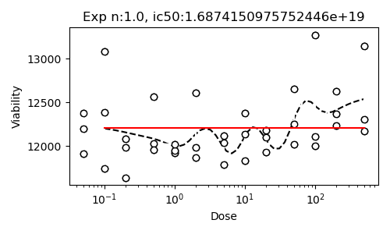
Negative control (saccharin, not cardiotoxic)

Slide 14
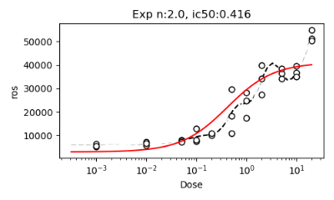
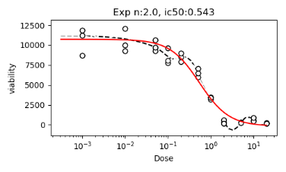
Positive control
Doxorubicin (cardiotoxic)

Slide 15
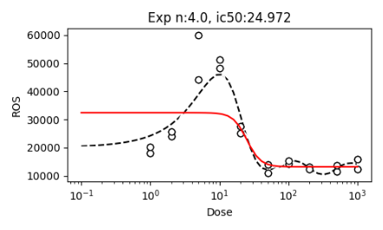
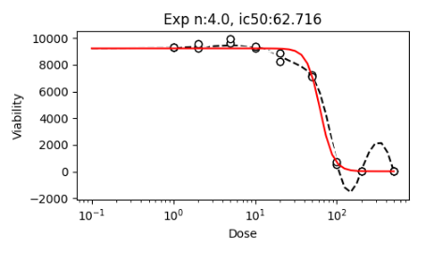
Amitryptiline (cardiotoxic)

Slide 16
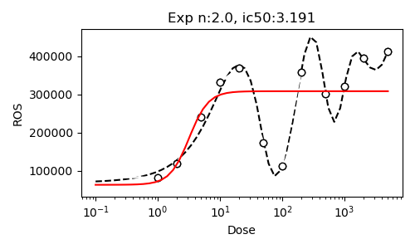
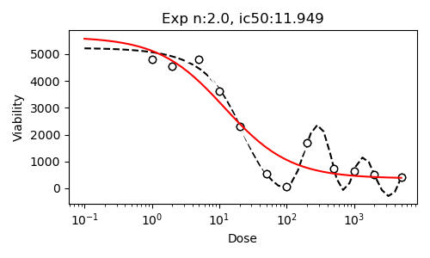
Rotenone (cardiotoxic)

Slide 17
Complexities
Different mechanisms of toxicity
Different pathways to ROS production
Not always directly linked to cell death

Slide 18
Solutions
Adverse Outcome Networks
Multiple measurements (omics)
A deep understanding of the in vitro system

Slide 19


Variability
Inter- versus intraspecies

Slide 20
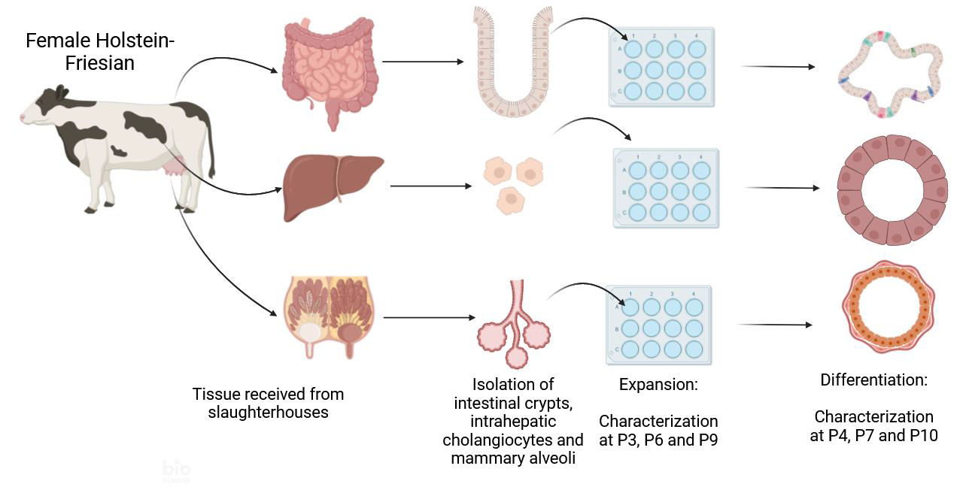
Bovine organoids to inform the in silico cow

Slide 21
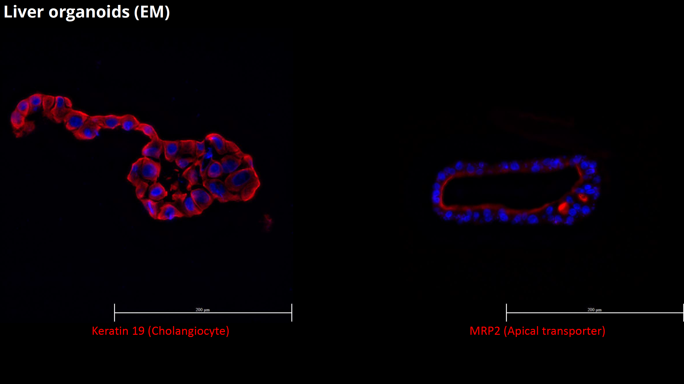

Slide 22
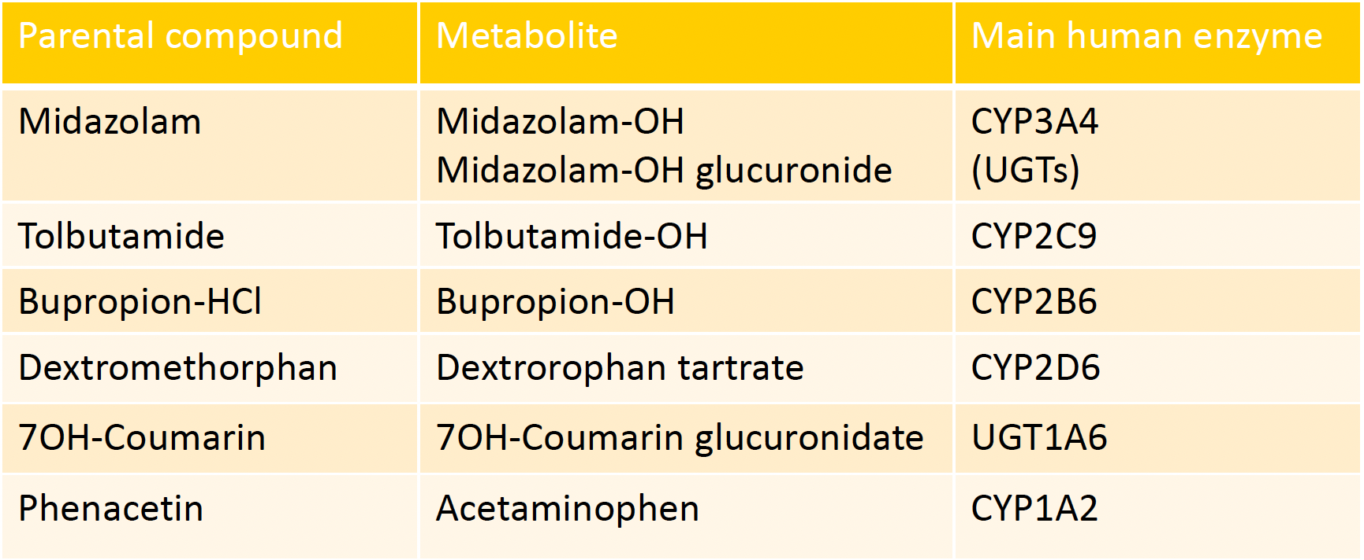
Metabolically active cells

Slide 23
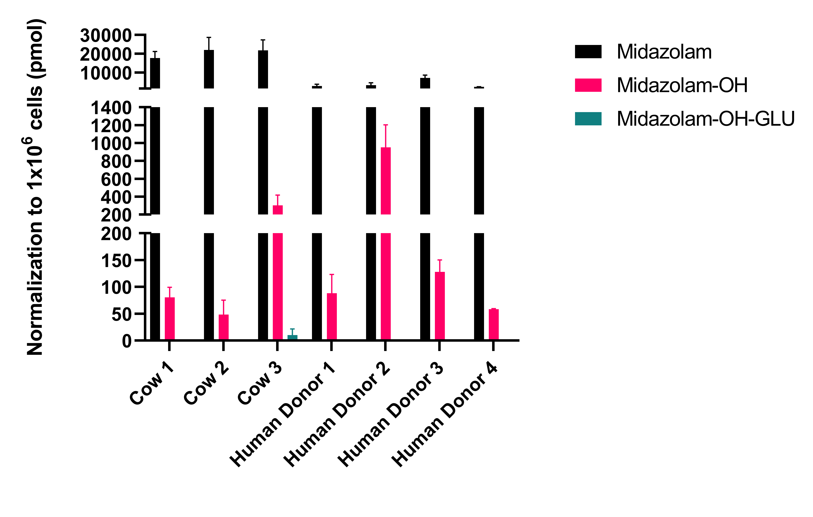
Midazolam

Slide 24
Complexities
Intraindividual variability
Experimental variability
Unknown pathways

Slide 25
Solutions
Standardisation

Slide 26
Acknowledgements

Slide 27
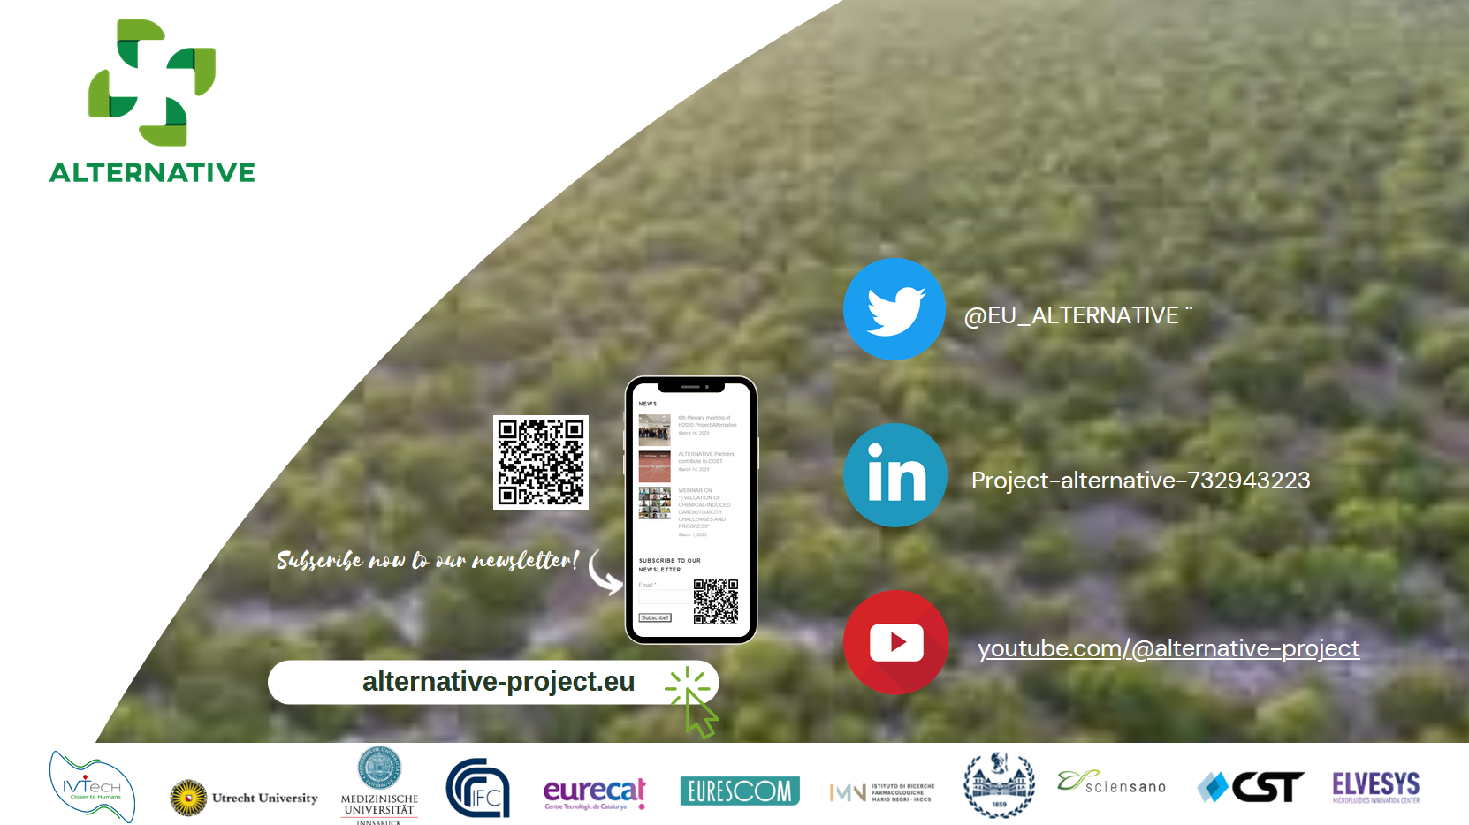




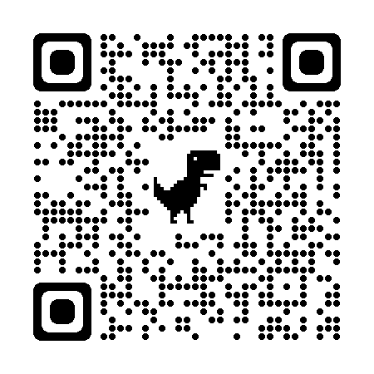

Slide 28

Questions?
Source: https://www.flickr.com/photos/darkwood67/3431956363

